Slide 1


Restaurant Management System
Beirt Arab University
Department of Electrical And Computer Engineering
Programming For Engineers
COMP215
Submitted to :
Eng. Hadi Al Mubasher
Fall 2021-2022
Done By:
Mohamad Maher Hazim
ID: 202100107
Georges Michel Skaf
ID: 20210931
Mohamad William Seif El Dine
ID: 202101418

Slide 2
A brief explanation about our project:
As the title name, Restaurant Management System, my mates and me, had to prepare a management system for a restaurant using python language.
It wasn’t easy at all, we had to work for days, to get the awaited result.
The system is pretty simple to manage, it was divided into several parts,
A first part was to let the costumer choose between normal and VIP lounge where VIP lounge had many features that don’t exist in the normal lounge.
Another part was choosing between food from different countries, such as Lebanese, French food…
There exist a part that count the quantity of each kind of food ordered,
And the last part where the count of the price will be delivered to the costumer.
In the next slides we’ll go deeply in our program details.

Slide 3
Topics used in our program:
Lists
For loop
If loop
Nested if loop
Functions
Dictionaries
While loop
Random number generator

Slide 4
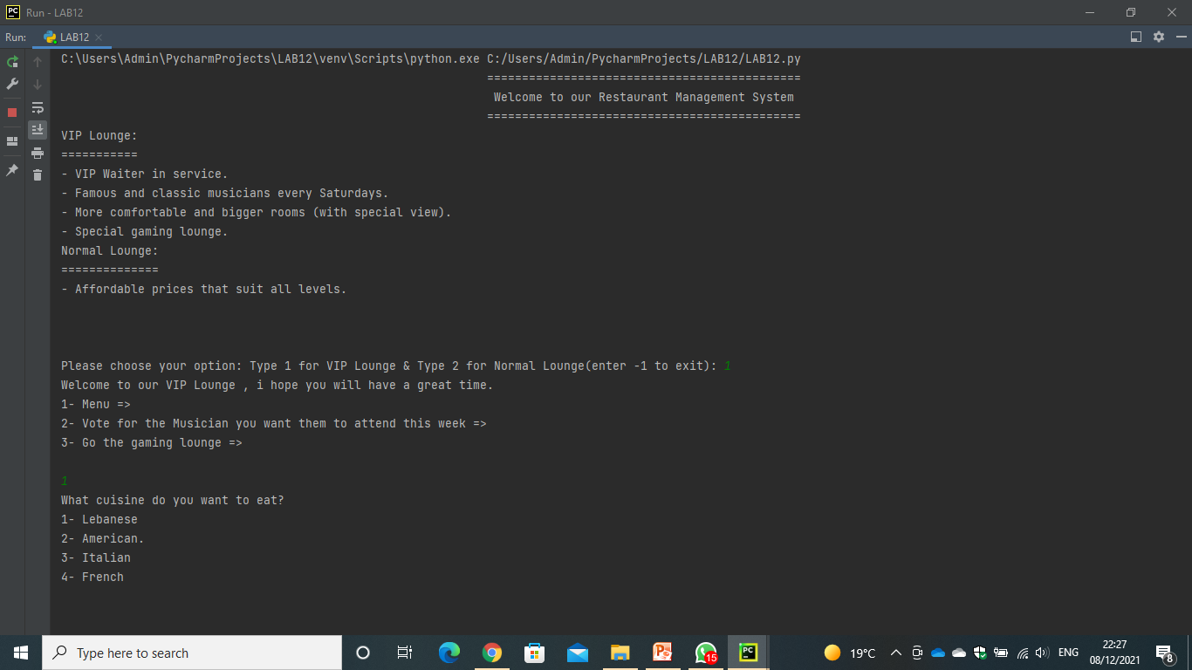
As we choose the VIP lounge, the program will lead us to detailed options in the VIP lounge, and by asking for the menu, it will lead us to different countries food, then we choose the country we want to eat from then we choose the dishes we want with the quantity needed, and finally the prices will be shown to the costumer.

Slide 5
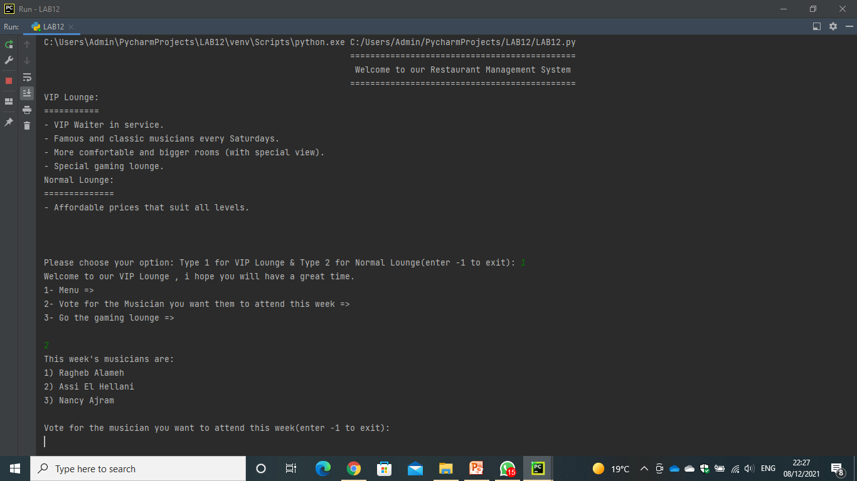
Asking for voting to the musician you want to attend for the week, will lead to three musicians name, then the costumer will choose one of them, in addition to this, costumer can skip this part even if he entered it.

Slide 6
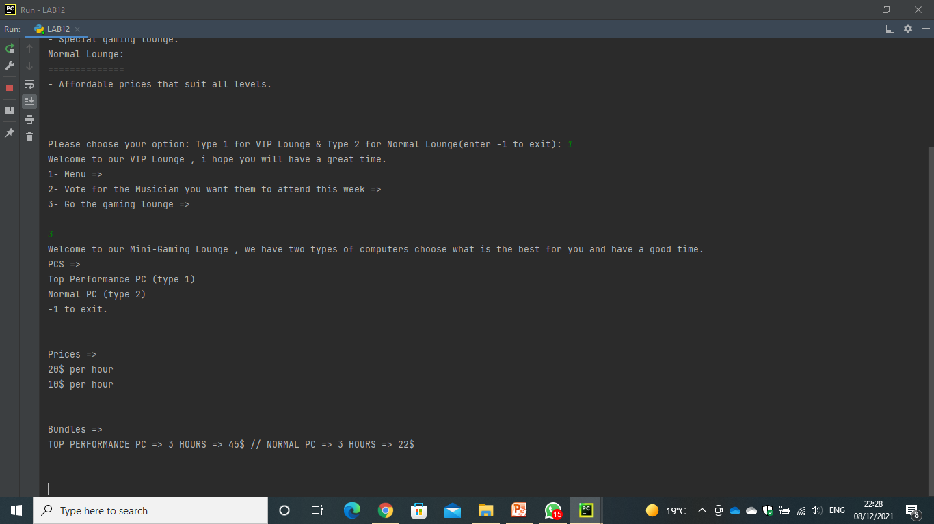
The final part in the VIP lounge is the gaming lounge, where costumer can get to the gaming lounge and choose either Top performance PCs or Normal Pcs and for sure each with it’s price. In addition to this, there exist bundles for costumers looking for long time playing.

Slide 7
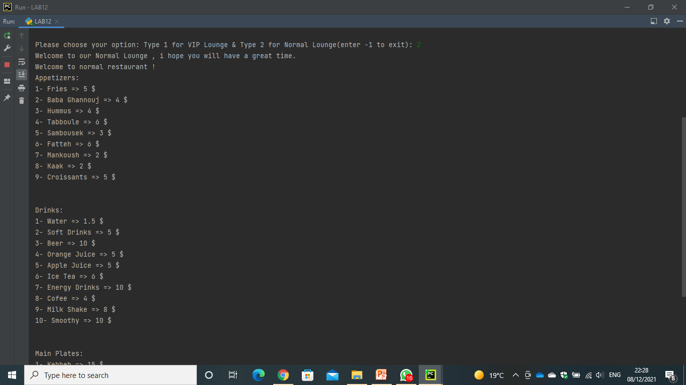
Second and last part of our program, Normal lounge, where it consists of affordable prices that suits people from all levels. It contains only local appetizers, main plates in addition to drinks.

Slide 8
All in all, this was our project, Restaurant Management System, we want to thank Dr. Ramzi Jaber for letting us get ideas in the easiet and simplest way, and Eng. Hadi Al Mubasher for his great effort in the practical side where new ideas were included and explained in a great way in order to get stonger and stronger in this languages.
Thank You!

